Slide 1

Introduction to Transport Layer
Lecture 6 | Part 1| CSE421 – Computer Networks
Department of Computer Science and Engineering School of Data & Science

Slide 2

Objectives
our goals:
understand principles behind transport layer services:
reliable data transfer, segmentation, flow control etc..
learn about Internet transport layer protocols:
UDP: connectionless transport
TCP: connection-oriented reliable transport

Slide 3


















Transport services and protocols
application
transport
network
data link
physical
provide logical communication between application processes running on different hosts
mobile network
national or global ISP
transport protocols actions in end systems:
sender: breaks application messages into segments, passes to network layer
receiver: reassembles segments into messages, passes to application layer
logical end-end transport
local or regional ISP
home network
content
provider
network
application
transport
network
data link
physical
datacenter
network
two transport protocols available to Internet applications
TCP, UDP
enterprise
network
Notes:
By logical communication , we
mean that from an application’s perspective, it is as if the hosts running the processes
were directly connected; in reality, the hosts may be on opposite sides of the
planet, connected via numerous routers and a wide range of link types. Application
processes use the logical communication provided by the transport layer to send
messages to each other, free from the worry of the details of the physical infrastructure
used to carry these messages.
Let’s look at each of these three (logical communications, actions,

Slide 4
Transport vs. Network layer
network layer: logical communication between hosts
transport layer: logical communication between processes
relies on, enhances, network layer services
household analogy:
12 kids in Ann’s house sending letters to 12 kids in Bill’s house:
hosts = houses
processes = kids
app messages = letters in envelopes
transport protocol = Ann and Bill who demux to in-house siblings
network-layer protocol = postal service

Slide 5
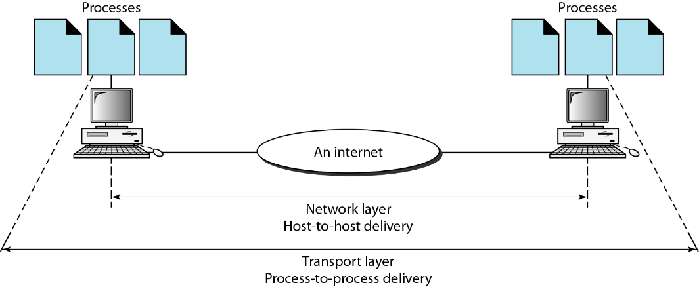
Transport Layer
The transport layer is responsible for the delivery of a message from one process (sender) to another (receiver).
Transport Layer PDU is called Segments
Functions:
Segmentation and Reassembly
Adds Port Address to identify the application
Multiplexing
Connection establishment and termination
Flow and Error Control
*PDU – Protocol Data Unit

Slide 6
Purpose of the Transport Layer
Primary responsibilities:
Segmenting the data and managing each piece.
Reassembling the segments into streams of application data.
Identifying the different applications.
Multiplexing
Initiating and terminating a session.
Performing flow control between end users.
Enabling error recovery.
Reliability

Slide 7
Reliability
Three basic operations of reliability are:
Initiating sessions and tracking transmitted data
Acknowledging received data
Retransmitting any unacknowledged data
To support these reliability operations, more control data is added in the Layer 4 header.

Slide 8
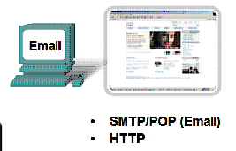
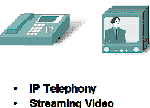
Different Applications
Different Requirements
Some applications need their data to be complete with no errors or gaps and they can accept a slight delay to ensure this.
Some applications can accept occasional errors or gaps in the data but they cannot accept any delay.

Slide 9
Solution : Two transport protocols?
Reliable
TCP
Fast
UDP

Slide 10
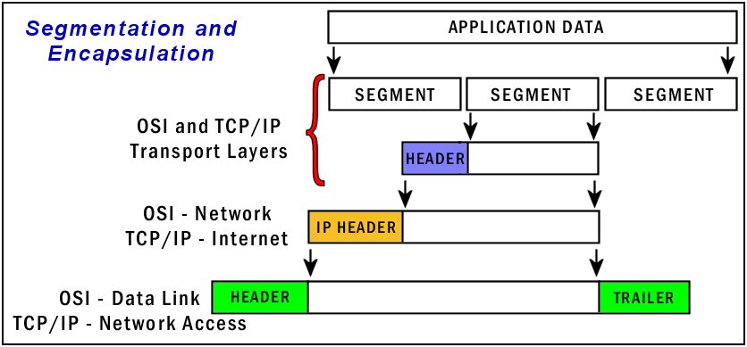
Function 1 – Segmentation and Reassembly

Slide 11
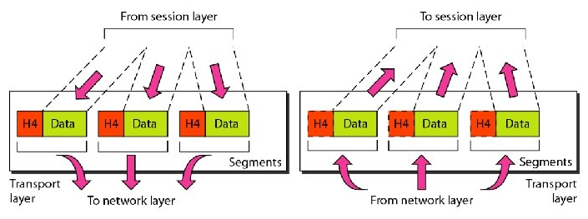
Function 1 – Segmentation and Reassembly
Also known as encapsulation and de-capsulation.

Slide 12
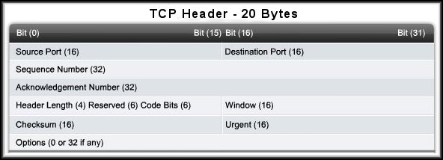
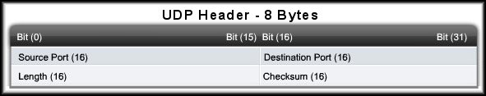
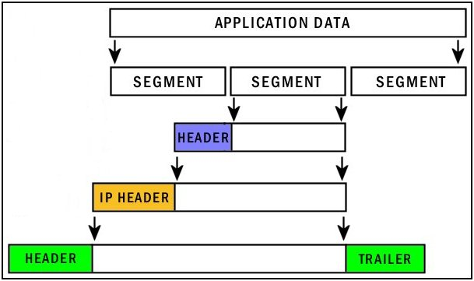
TCP and UDP Headers

Slide 13
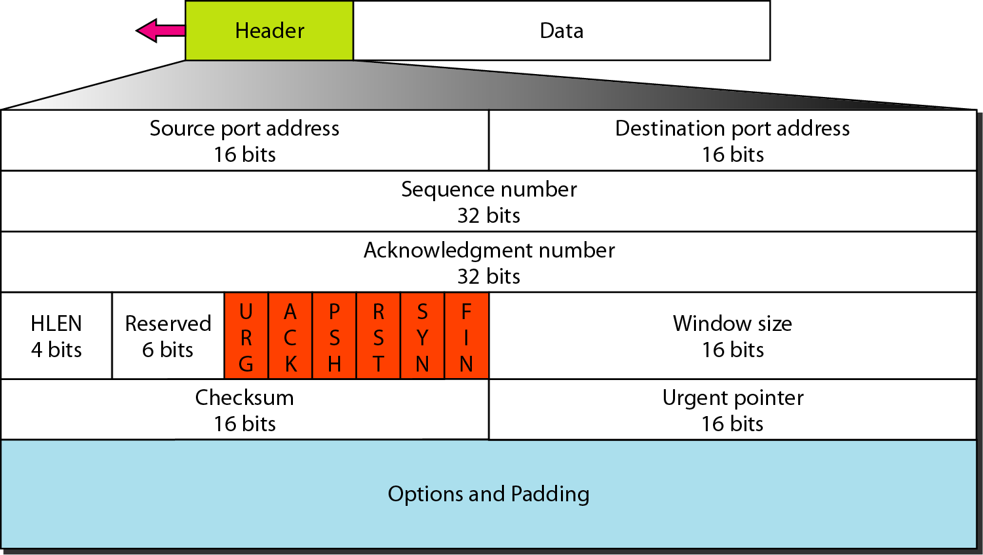
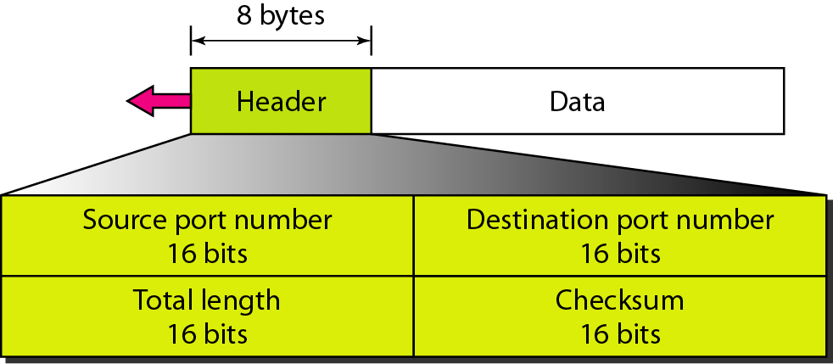
TCP and UDP Headers
TCP Header
UDP Header

Slide 14
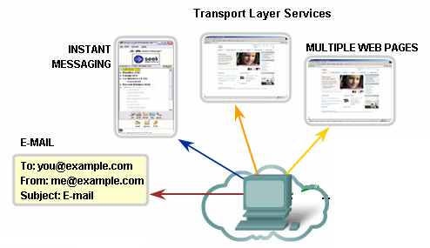
Function2 – Identification Applications Using Port Address
Port Numbers/Addresses are used to identify different applications/processes running in a computer
16-bit in length
Represented as one single decimal number
Range 0 - 65535
e.g. 80 – Web; 25 – SMTP
110 – POP3, 531 – Instant Messaging

Slide 15
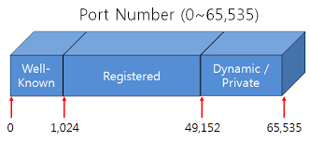
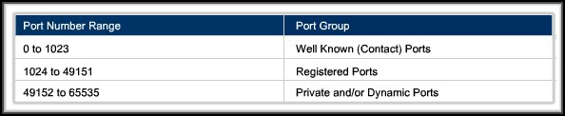
Port Numbers
Internet Corporation for Assigned Names and Numbers (ICANN) assigns port numbers.
Three categories:

Slide 16
Port Addressing Types
Well-Known Ports:
Reserved for common services and applications.
Pre-assigned by ICANN
20 – FTP Data
443 – HTTPS
25 – SMTP
21 – FTP Control
69 – TFTP
110 – POP3
23 – Telnet
520 – RIP

Slide 17
Port Addressing Types
Registered Ports:
Port numbers that companies and other users register with ICANN for use by the applications that communicate using any one of the transport layer protocols.
8008 – Alternate HTTP
1863 – MSN Messenger
5004 – RTP
8080 – Alternate HTTP
5060 – SIP (VoIP)

Slide 18
Port Addressing Types
Dynamic Ports:
Assigned to a user application at connect time.
Dynamic port usage will become clearer as we move through the material.

Slide 19
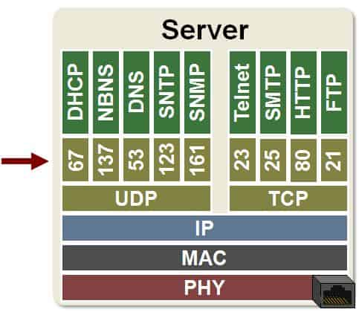
Port Numbers
UDP Port Numbers
TCP Port Numbers

Slide 20





Function 3 -Multiplexing
HTTP server
client
application
application
HTTP msg
transport
transport
network
transport
network
link
network
link
physical
link
physical
physical

Slide 21
Multiplexing
HTTP server
client
application
application
HTTP msg
transport
H_{t}
HTTP msg
transport
network
transport
network
link
network
link
physical
link
physical
physical

Slide 22
Multiplexing
HTTP server
client
application
application
HTTP msg
transport
H_{t}
HTTP msg
H_{n}
H_{t}
network
transport
HTTP msg
transport
network
link
network
link
physical
link
physical
physical

Slide 23
Multiplexing
HTTP server
client
application
application
transport
transport
network
transport
network
link
network
link
physical
link
physical
physical
H_{n}
H_{t}
HTTP msg

Slide 24

Multiplexing
HTTP server
client₁
client₂
application
P-client₁
P-client₂
application
transport
transport
network
transport
network
link
network
link
physical
link
physical
physical

Slide 25
Multiplexing/demultiplexing
multiplexing at sender:
demultiplexing at receiver:
handle data from multiple
sockets, add transport header (later used for demultiplexing)
use header info to deliver
received segments to correct
socket
application
application
P1
P2
application
socket
P3
transport
P4
process
transport
network
transport
network
link
network
link
physical
link
physical
physical

Slide 26
How demultiplexing works
host receives IP datagrams
each datagram has source IP address, destination IP address
each datagram carries one transport-layer segment
each segment has source, destination port number
host uses IP addresses & port numbers to direct segment to appropriate socket
32 bits
source port #
dest port #
other header fields
application
data
(payload)
TCP/UDP segment format

Slide 27
Connectionless demultiplexing
when creating datagram to send into UDP socket, must specify
destination IP address
destination port #
when receiving host receives UDP segment:
checks destination port # in segment
directs UDP segment to socket with that port #
IP/UDP datagrams with same dest. port #, but different source IP addresses and/or source port numbers will be directed to same socket at receiving host

Slide 28
Connectionless demultiplexing: an example
DatagramSocket serverSocket = new DatagramSocket
(6428);
DatagramSocket mySocket2 = new DatagramSocket
(9157);
DatagramSocket mySocket1 = new DatagramSocket (5775);
application
application
P1
application
P3
P4
transport
transport
network
transport
network
link
network
link
physical
link
physical
physical
source port: 6428
dest port: 9157
source port: ?
dest port: ?
source port: 9157
dest port: 6428
source port: ?
dest port: ?

Slide 29
Connection-oriented demultiplexing
TCP socket identified by 4-tuple:
source IP address
source port number
dest IP address
dest port number
server may support many simultaneous TCP sockets:
each socket identified by its own 4-tuple
each socket associated with a different connecting client
demux: receiver uses all four values (4-tuple) to direct segment to appropriate socket

Slide 30

Connection-oriented demultiplexing: example
application
application
P4
P5
P6
application
P1
P2
P3
transport
transport
network
transport
network
link
network
link
physical
link
physical
server: IP address B
physical
host: IP address A
source IP,port: B,80
dest IP,port: A,9157
host: IP address C
source IP,port: C,5775
dest IP,port: B,80
source IP,port: A,9157
dest IP, port: B,80
source IP,port: C,9157
dest IP,port: B,80
Three segments, all destined to IP address: B,
dest port: 80 are demultiplexed to different sockets

Slide 31
Summary
Multiplexing, demultiplexing: based on segment, datagram header field values
UDP: demultiplexing using destination port number (only)
TCP: demultiplexing using 4-tuple: source and destination IP addresses, and port numbers
Multiplexing/demultiplexing happen at all layers

Slide 32
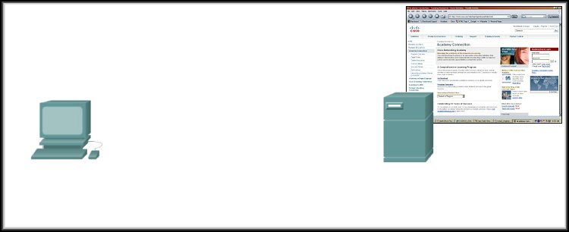
More on Port Numbers
Source = 49650 Destination = 80
Server is listening on Port 80 for HTTP connections.
The client sets the destination port to 80 and uses a dynamic port as its source.

Slide 33

Port Numbers in Action
Source = 80 Destination = 49650
Server replies with the web page.
Sets the source port to 80 and uses the client’s source port as the destination.

Slide 34
Port Numbers in Action
Source = 49650 Destination = 80
Source = 80 Destination = 49650
Notice how the source and destination ports are used.
Clients can use any random port number, servers can’t.
Because clients won’t be able to identify server process otherwise
Servers, however, cannot use any random port number
Use of well-known port numbers!

Slide 35
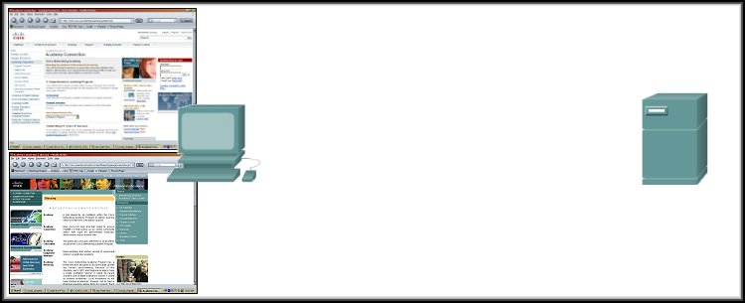
Port Numbers in Action
Source = 49650 Destination = 80
Source = 80 Destination = 49650
172.16.230.5
207.22.146.33
Source = 49655 Destination = 80
Source = 80 Destination = 49655
What if there are two sessions to the same server?
The client uses another dynamic port as its source and the destination is still port 80.
Different source ports keep the sessions unique on the server.

Slide 36
Port Numbers in Action
Source = 49650 Destination = 80
Source = 80 Destination = 49650
172.16.230.5
207.22.146.33
Source = 49655 Destination = 80
Source = 80 Destination = 49655
How does the Transport Layer keep them separate?
The socket (IP Address:Port)
172.16.230.5:49650 172.16.230.5:49655
207.22.146.33:49650 207.22.146.33:49655

Slide 37
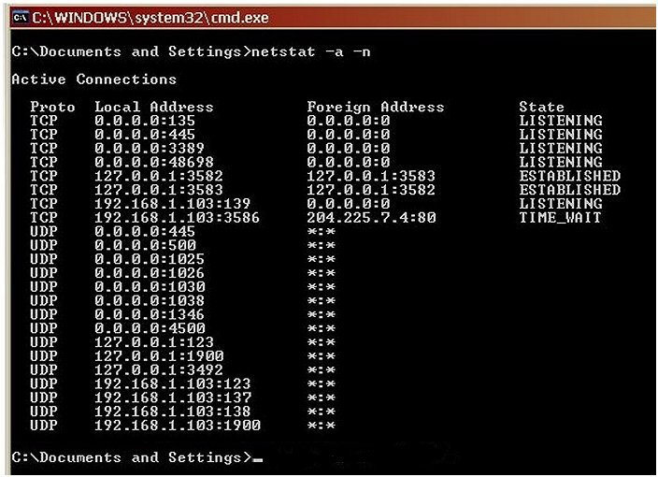
Port Addressing Types and Tools
Source IP
Source Port
Destination IP
Destination Port
TCP/UDP
Netstat - Network Utility Tool
Source Socket
Connection State
Destination Socket
netstat –a –n command
Actually, when you open up a single web page, there are usually several TCP sessions created, not just one.

Slide 38
UDP: User Datagram Protocol [RFC 768]
UDP is a connectionless, unreliable protocol that has no flow and error control. It uses port numbers to track and multiplex data received from the application layer.
why is there a UDP?
no connection establishment (which can add delay)
simple: no connection state at sender, receiver
small header size
no congestion control: UDP can blast away as fast as desired

Slide 39
UDP
UDP use:
streaming multimedia apps (loss tolerant, rate sensitive)
DNS
SNMP
HTTP/3
reliable transfer over UDP:
add reliability at application layer
application-specific error recovery!

Slide 40
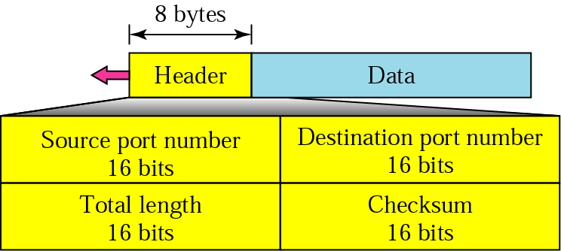
User Datagram Protocol (UDP)
Figure 14: User Datagram Header format
Connectionless
No reassembly to order.
No Error checking
No Flow control

Slide 41

UDP checksum
Goal: detect errors (i.e., flipped bits) in transmitted segment
1st number
2nd number
sum
Transmitted: 5 6 11
Received: 4 6 11
receiver-computed
checksum
=
sender-computed
checksum (as received)

Slide 42
UDP checksum
Goal: detect errors (i.e., flipped bits) in transmitted segment
sender:
treat contents of UDP segment (including UDP header fields and IP addresses) as sequence of 16-bit integers
checksum: addition (one’s complement sum) of segment content
checksum value put into UDP checksum field
receiver:
compute checksum of received segment
check if computed checksum equals checksum field value:
Not equal - error detected
Equal - no error detected. But maybe errors nonetheless? More later ….

Slide 43
Internet checksum: an example
example: add two 16-bit integers
1 1 1 0 0 1 1 0 0 1 1 0 0 1 1 0
1 1 0 1 0 1 0 1 0 1 0 1 0 1 0 1
wraparound
1 1 0 1 1 1 0 1 1 1 0 1 1 1 0 1 1
sum
1 0 1 1 1 0 1 1 1 0 1 1 1 1 0 0
checksum
0 1 0 0 0 1 0 0 0 1 0 0 0 0 1 1
Note: when adding numbers, a carryout from the most significant bit needs to be added to the result
* Check out the online interactive exercises for more examples: http://gaia.cs.umass.edu/kurose_ross/interactive/

Slide 44
Internet checksum: weak protection!
example: add two 16-bit integers
0 1
1 1 1 0 0 1 1 0 0 1 1 0 0 1 1 0
1 0
1 1 0 1 0 1 0 1 0 1 0 1 0 1 0 1
wraparound
1 1 0 1 1 1 0 1 1 1 0 1 1 1 0 1 1
Even though numbers have changed (bit flips), no change in checksum!
sum
1 0 1 1 1 0 1 1 1 0 1 1 1 1 0 0
checksum
0 1 0 0 0 1 0 0 0 1 0 0 0 0 1 1

Slide 45
THE END

